Slide 1

6th Grade Accelerated Math
Unit 12, Lesson 2 Using Proportions to Solve Problems Volume 2, pg. 218

Slide 2


Benchmark
MA.7.AR.3.2
Apply previous understanding of ratios to solve real-world problems involving proportions.
volume 2, pg. 218

Slide 3
Integrated Mathematical Thinking and Reasoning Standards
MA.K12.MTR.4.1 Engage in discussions that reflect on the mathematical thinking of self and others.
volume 2, pg. 218

Slide 4

Learning Target
I can solve problems using proportions.
volume 2, pg. 218

Slide 5

Warm-Up
volume 2, pg. 218

Slide 6
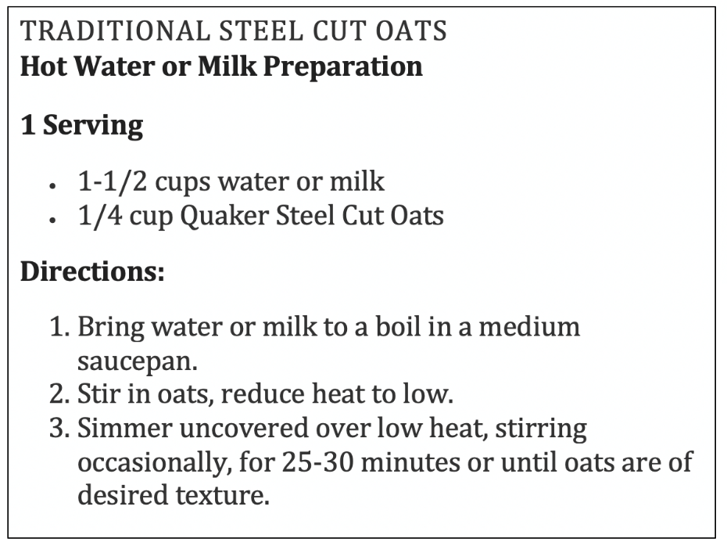
12.2.1 Warm-Up: Making More Servings
Gabriel wants to make $5$ servings of oatmeal for breakfast using this recipe. How much water and oats will he need to use? Show your work.
volume 2, pg. 218

Slide 7

Guided Instruction
volume 2, pg. 219

Slide 8
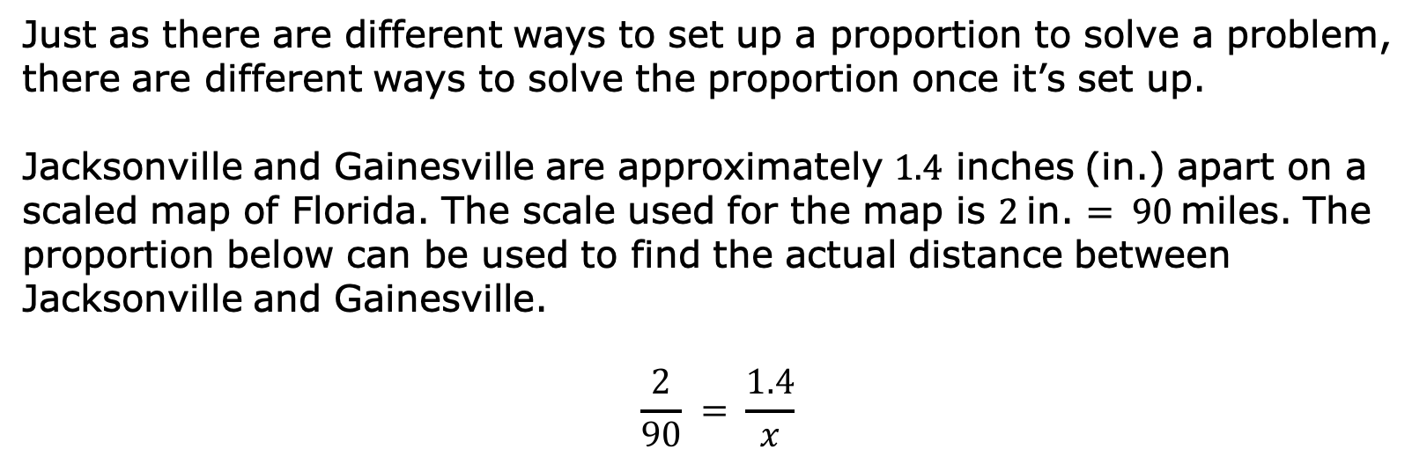
12.2.2 Guided Instruction: Solving Proportions
Just as there are different ways to set up a proportion to solve a problem, there are different ways to solve the proportion once it’s set up.
Jacksonville and Gainesville are approximately $1.4$ inches (in.) apart on a scaled map of Florida. The scale used for the map is $2$in. $= 90$miles. The proportion below can be used to find the actual distance between Jacksonville and Gainesville.
$$\frac{2}{90} = \frac{1.4}{x}$$
volume 2, pg. 219

Slide 9
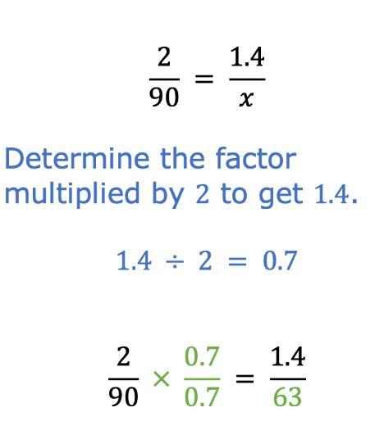
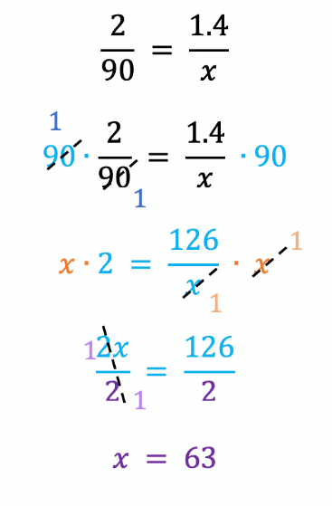
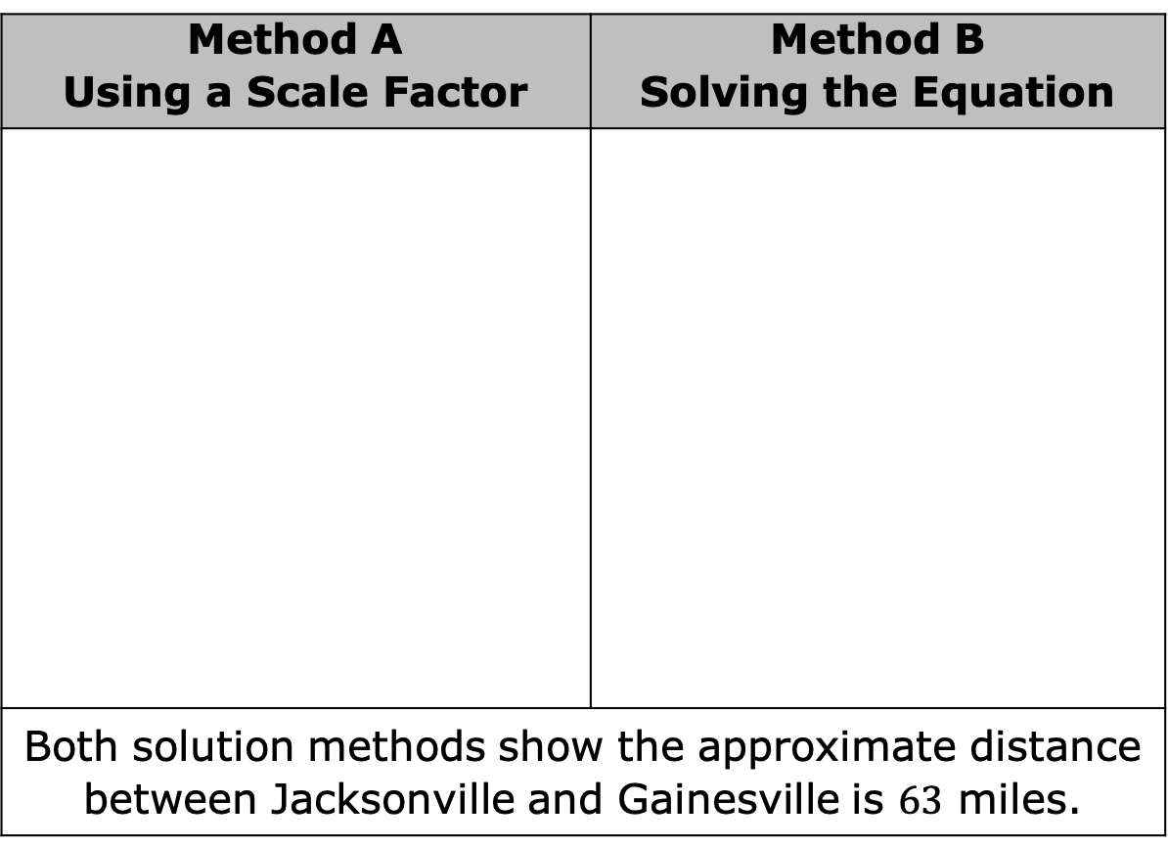
Two methods for solving the proportion are shown.
Method A Using a Scale Factor | Method B Solving the Equation
Both solution methods show the approximate distance between Jacksonville and Gainesville is $63$ miles.
volume 2, pg. 219

Slide 10
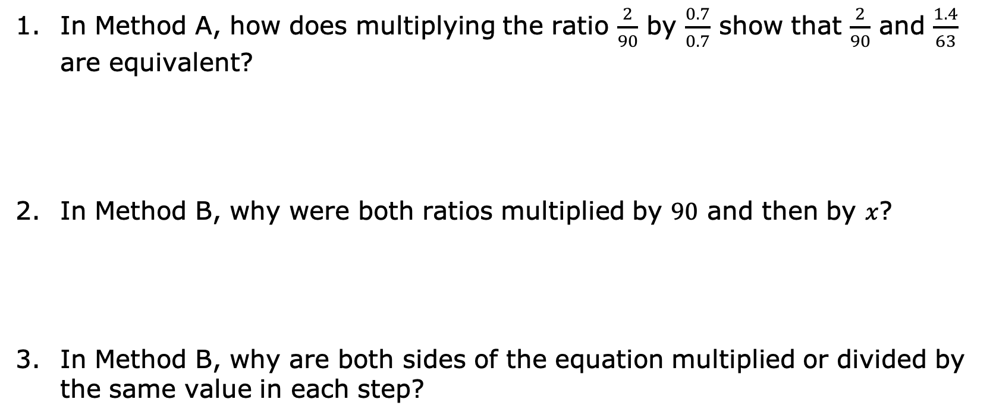
In Method A, how does multiplying the ratio $\frac{2}{90}$ by $\frac{0.7}{0.7}$ show that $\frac{2}{90}$ and $\frac{1.4}{63}$ are equivalent?
In Method B, why were both ratios multiplied by $90$ and then by $x$?
In Method B, why are both sides of the equation multiplied or divided by the same value in each step?
volume 2, pg. 219

Slide 11
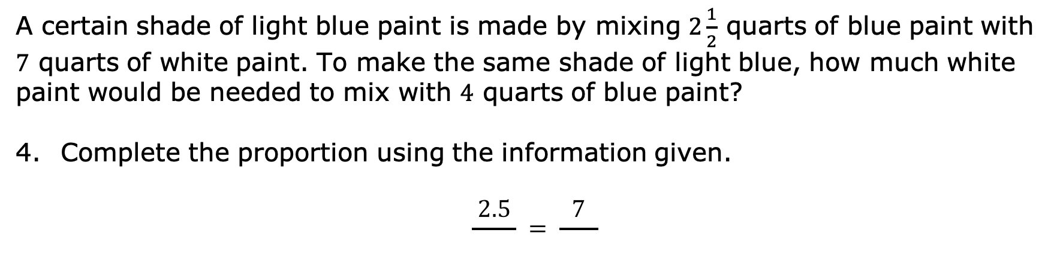
A certain shade of light blue paint is made by mixing $2\frac{1}{2}$ quarts of blue paint with $7$ quarts of white paint. To make the same shade of light blue, how much white paint would be needed to mix with $4$ quarts of blue paint?
Complete the proportion using the information given.
$$\frac{2.5}{ } = \frac{7}{ }$$
volume 2, pg. 219

Slide 12
With your partner, decide who is Partner A and who is Partner B. Then solve the proportion using the method indicated in the space provided.
Partner A - Method A Using a Scale Factor | Partner B - Method B Solving the Equation
volume 2, pg. 220

Slide 13
Check your work with your partner, making any necessary corrections. Once both partners agree, write your partner’s method in your workbook. Then complete the statement.
To make the same shade of light blue, _____ quarts of white paint would be needed.
volume 2, pg. 220

Slide 14

Collaboration
volume 2, pg. 220

Slide 15

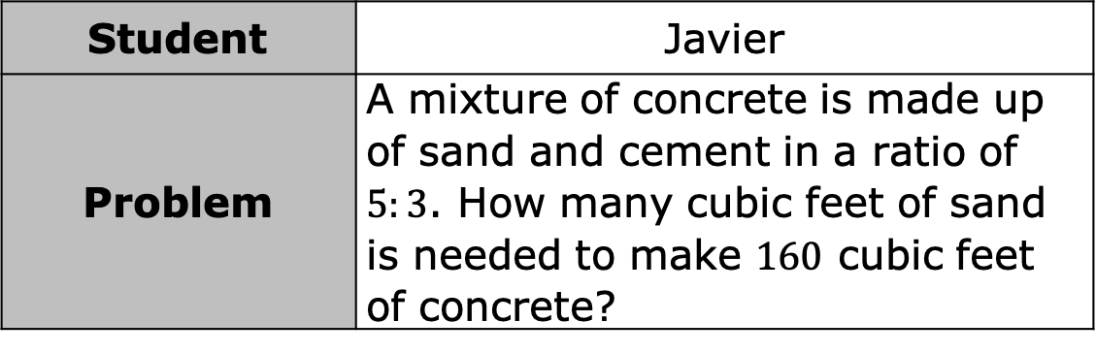
12.2.3 Collaboration: Examining Student Work
Four students solved different problems involving proportional relationships. Each student’s work is shown, including any errors they may have made. Work with your partner or a small group to examine each student’s work and complete the table that follows.
Student | Javier
Problem | A mixture of concrete is made up of sand and cement in a ratio of $5:3$. How many cubic feet of sand is needed to make $160$ cubic feet of concrete?
volume 2, pg. 220

Slide 16
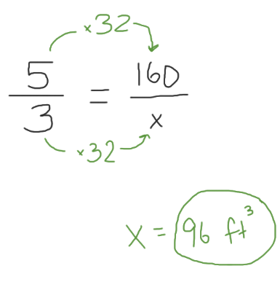
Student’s Work
What did Javier do correctly? | What error(s) did Javier make? | Find the correct answer.
volume 2, pg. 220

Slide 17
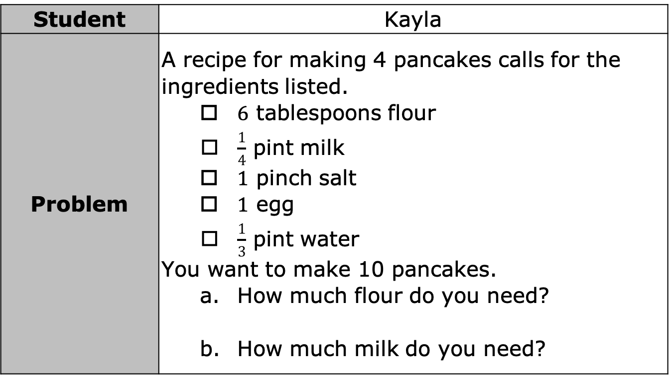
Student | Kayla
Problem | A recipe for making 4 pancakes calls for the ingredients listed. $6$ tablespoons flour $\frac{1}{4}$ pint milk $1$ pinch salt $1$ egg $\frac{1}{3}$ pint water You want to make 10 pancakes. How much flour do you need? How much milk do you need?
volume 2, pg. 221

Slide 18
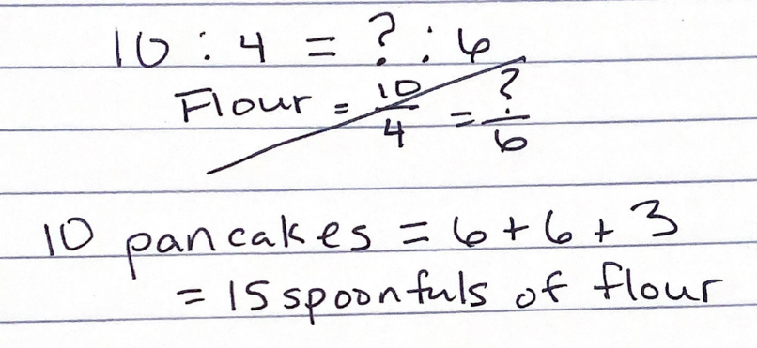
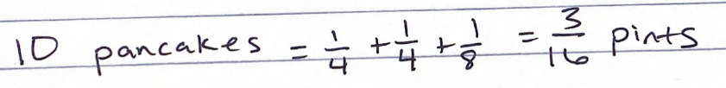
Student’s Work | How much flour do you need? How much milk do you need?
volume 2, pg. 221

Slide 19
What did Kayla do correctly? | What error(s) did Kayla make? | Find the correct answers.
volume 2, pg. 221

Slide 20
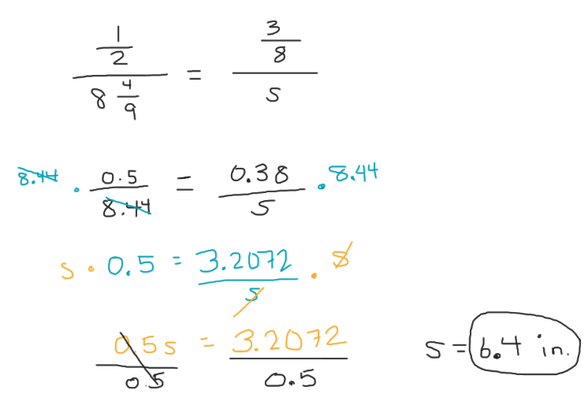
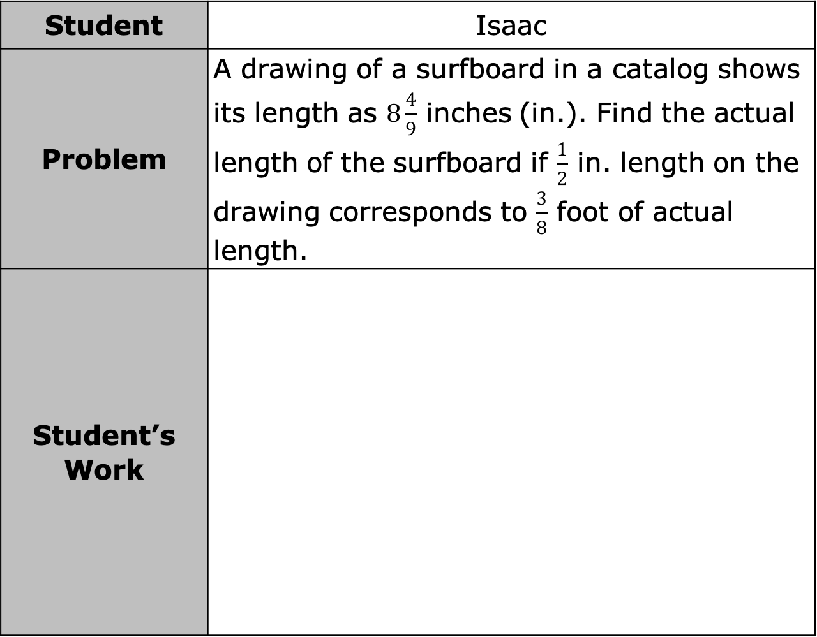
Student | Isaac
Problem | A drawing of a surfboard in a catalog shows its length as $8\frac{4}{9}$ inches (in.). Find the actual length of the surfboard if $\frac{1}{2}$ in. length on the drawing corresponds to $\frac{3}{8}$ foot of actual length.
Student’s Work
volume 2, pg. 221

Slide 21
What did Isaac do correctly? | What error(s) did Isaac make? | Find the correct answers.
volume 2, pg. 221

Slide 22
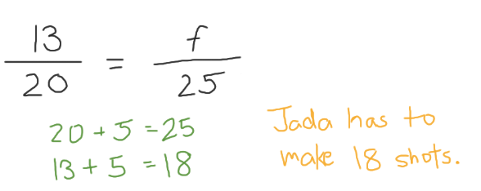
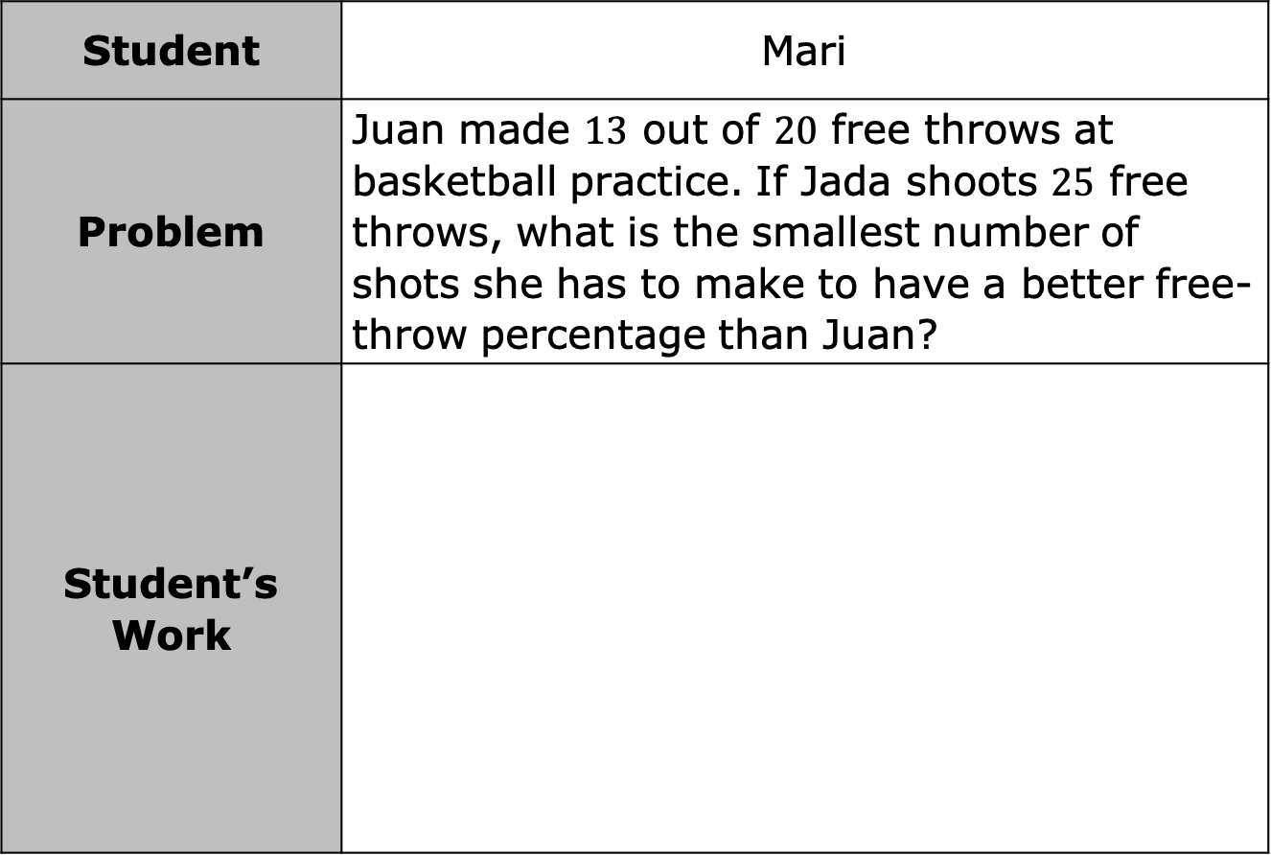
Student | Mari
Problem | Juan made $13$ out of $20$ free throws at basketball practice. If Jada shoots $25$ free throws, what is the smallest number of shots she has to make to have a better free-throw percentage than Juan?
Student’s Work
volume 2, pg. 222

Slide 23
What did Mari do correctly? | What error(s) did Mari make? | Find the correct answers.
volume 2, pg. 222

Slide 24

Bring It Together
volume 2, pg. 222

Slide 25

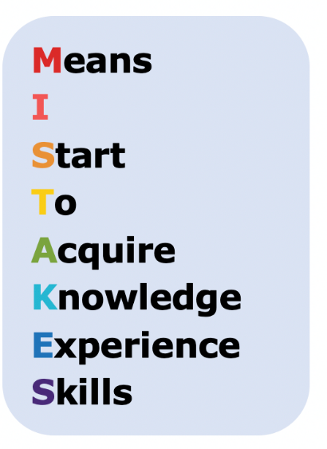

12.2.4 Bring It Together: Proportions
Mistakes create opportunities to learn! Based on the mistakes you observed when examining other students’ work, use the space provided to describe at least two things you learned and want to keep in mind when using proportions to solve problems.
volume 2, pg. 223

Slide 26

Your Turn
volume 2, pg. 223

Slide 27
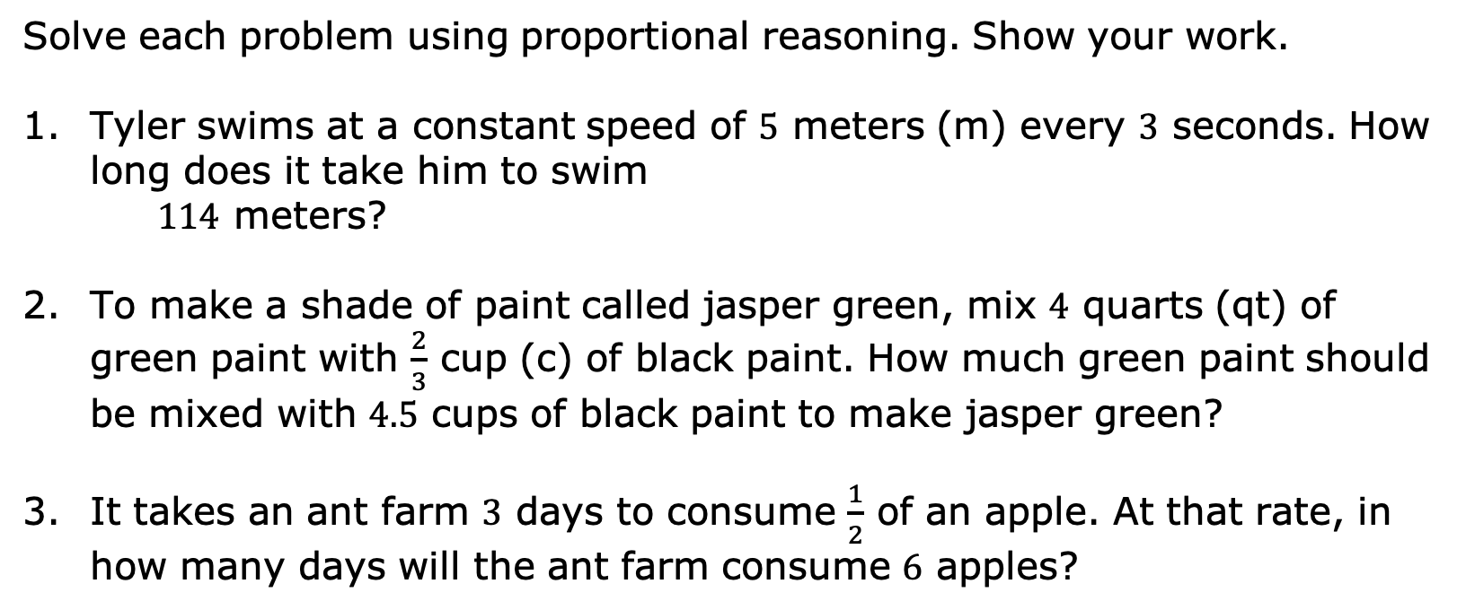
12.2.5 Your Turn!
Solve each problem using proportional reasoning. Show your work.
Tyler swims at a constant speed of $5$ meters (m) every $3$ seconds. How long does it take him to swim
$114$ meters?
To make a shade of paint called jasper green, mix $4$ quarts (qt) of green paint with $\frac{2}{3}$ cup (c) of black paint. How much green paint should be mixed with $4.5$ cups of black paint to make jasper green?
It takes an ant farm $3$ days to consume $\frac{1}{2}$ of an apple. At that rate, in how many days will the ant farm consume $6$ apples?
volume 2, pg. 223

Slide 28

Wrap-Up
volume 2, pg. 223

Slide 29
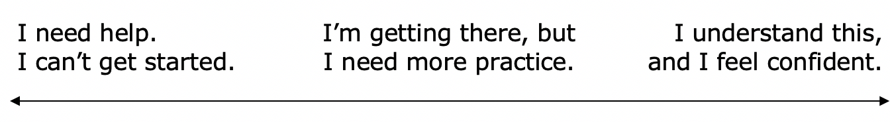
12.2.6 Wrap-Up: Reflection
Draw an X on each line to indicate where your current learning is in relation to today’s learning target.
I can solve problems using proportions.
Explain why you placed your X where you did.
volume 2, pg. 223

